Slide 1
Final Coaches’ Meeting
It’s the final countdown . . . . .
Agenda -
Specific Tournament Information
You will get your
long term & spontaneous times
your workers’ assignment
at the end of this meeting

Slide 2
Regional Tournament
Viera High School
Saturday, February 17, 2024
6103 Stadium Parkway
Viera, FL 32940

Slide 3
State Tournament
Orange County Convention Center South Concourse
Saturday, March 30, 2024
Teams advancing to state need to register and pay a $250 tournament fee (Primary $100) within two weeks of our regional tournament

Slide 4
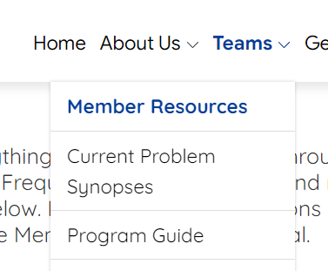
Program Guide
Refer to the Program Guide often
https://www.odysseyofthemind.com/program-guide/

Slide 5
From the Problem Captains…..
Review paperwork with the team
Arrive at Pre-Staging 15 - 20 minutes prior to Performance time
Have a backup plan …….
Spontaneous Ideas for Long Term problem “problems”:
Round Robin format
What can go wrong?
How can we fix it?
Prepare for things to go wrong

Slide 6
Primary - Sarah Holmes (PC) and
Judy Carr (APC)
Don’t panic! Remember Primary is noncompetitive!
We will be allocated spots for primary teams at state.
Please speak to your parents about participating at state.
If we have more teams interested in going to State than allocations, we will draw names.
Coaches of teams going to State will need to be at the “going to state meeting” following the Award Ceremony.

Slide 7
Problem 1 - Lisa DeVries
Gymnasium wood floor - smooth
If your team damages the floor, your team is responsible for repairs

Slide 8
Problem 2 - Lara Tarillo
will also be in the gym on wood floor
brand new clarifications just posted on Jan 31

Slide 9
Problem 3 - Kim and Rob Dickman
Must have 4 copies of Style Form and Team List
Arrive 15 minutes before your competition time

Slide 10
Problem 4 - Mandi Carr
WEIGH-IN ROOM OPENS AT 7:50 A.M.
Your team’s weigh-in time is listed on the information sheet given tonight and the schedule will also be posted on the weigh-in room door. Your team may show up earlier but teams scheduled before your team will jump the line.
Teams need to bring the structure, the container/packaging or receipt of the glue which describes type of glue, and receipt/invoice from CCI if balsa wood was purchased from them during current year.
Team members only in weigh in.
Weigh-in judges do not touch the structure but ask team members to manipulate it,
If the structure fails to meet specifications, teams will be given a reasonable amount of time to make corrections, but they must be done at least 20 minutes prior to staging time.
We will provide a minimum of 400 lbs. of weights in assorted sizes, generally from 5 lbs. to 45 lbs. (2.28kg to 20.41kg), each with a hole 2” (5.1cm) in diameter. When registering for a tournament, teams needing more weight should notify the Tournament Director. Teams are not allowed to bring and use their own weights.

Slide 11
PROBLEM 5 - Becky and Gene Sims
Have team check and verify that items listed on the style form are not scored anywhere else
Remind teams to read and consider any general clarifications pertaining to their problem
Follow H 3 - Four copies of the lyrics to the original song required in the performance
Follow B 12 b regarding baking soda - b. must not harm or cause damage to the floor, performance area, judges, or audience, etc. as described in the Program Guide and must be self-contained or be able to be cleaned up without interfering with the competition schedule.
You must clean up after yourselves or be penalized
Have fun on Tournament Day!

Slide 12
SPONTANEOUS - Kat Gerding
No spectators - adults wait outside
Please remember to collect all watches, phones, electronic devices before team heads into spontaneous
You will not see a breakdown of your scores
Primary gets feedback because they aren't competitive
Report 10 minutes before your scheduled time and check in at table outside building 3
When the team is called, only the team will go inside with the judge - all may participate
Encourage families to be a cheering squad when team exits
REMEMBER THE TEAM MUST NOT DISCUSS THE PROBLEM OUTSIDE THE COMPETITION ROOM

Slide 13
Team Check-in
When you arrive on campus, you must check-in your team at the Team Check-In (end of breezeway).
If you fail to check-in, we will assume your team is not attending. Your performance time might be given to another team experiencing scheduling issues.
Bring the team paperwork for Long-Term and the Behavior Contracts - turn in contracts (paper clipped together) and be ready to show LT paperwork.
We will be checking that you have all LT forms filled out. We will not be checking if forms are correct.
If you are missing any paperwork, we will have blank forms available.
You will then receive your coach(es) designation, which you will need to have available to speak to a head judge and to pick up scores.

Slide 14
Alumni???
Please let us know if you are an alumni. We have several alumni on our regional board and on the state board. Some of our judges are also alumni. We want to include an alumni ribbon in your coach packet. Wear it that day along with your coach button.

Slide 15
What Long Term paperwork will my team need the day of competition?
4 completed copies of Style form
4 completed copies of Team list - ALL PROBLEMS
1 completed Outside Assistance form
1 completed Cost form
Team specific clarifications
Any additional problem specific paperwork
REMEMBER:
Primary & DIV I AN ADULT CAN WRITE DOWN WHAT THE TEAM DICTATES
DIV II & III FORMS MUST BE COMPLETED BY A TEAM MEMBER

Slide 16
STYLE FORM
4 completed copies for Staging Judge
Elaborates Long-Term problem
Relates to the solution’s theme
Team can showcase strengths
Cannot be items already scored as part of Long-Term
Categories
Specific Scoring Elements
Free Choice Elements (describe the free choice)
Overall Effect
Be very specific when describing elements on form.
Artistic design, music, songs, choreography
Construction, creative use of materials
Humor, rhyme
Overall effect (theme)

Slide 17
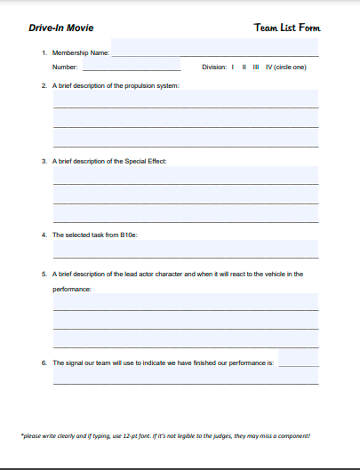
Team List
4 completed copies to the Staging Judge
Requirements that must be included on the list are found at the end of Section B in each problem.
Write legibly or type using at least 12 pt font
THIS LIST HELPS THE JUDGES KNOW WHAT TO LOOK FOR!

Slide 18
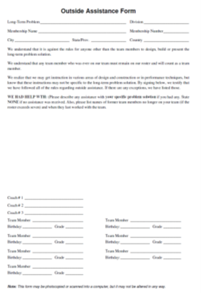
Outside Assistance Form
Team Completes
If no outside assistance, write NONE
EACH TEAM MEMBER AND COACH MUST SIGN THE FORM

Slide 19
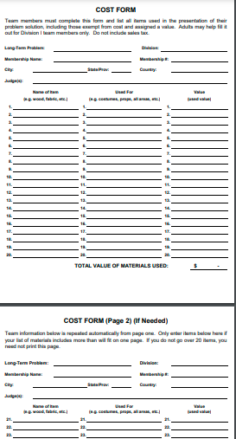
COST FORM
1 copy for Staging Judge
Must represent everything used during the LT & Style (balsa used for structure in P4 doesn’t count in cost limit)
Doesn’t include items not used during presentation such as practice structures or remainder of a can of paint
“Garage sale value” if used items
Combine value of small items – “Miscellaneous”
Assigned Value/Exemptions - refer to program guide
String, duct-tape, even “donations” all have value

Slide 20
Cost Exemptions - some items are exempt from cost - batteries, trash items, street clothes that are not part of performance…HOWEVER, all exempt items must be listed on cost form and given a value of $0 - NEW this year
Assigned Value Items - some items have an assigned value – such as musical instruments and 3-D printed items
Have your team check the program guide when filling out the cost form!
https://www.odysseyofthemind.com/program-guide/#assigning-cost

Slide 21
All Problems
H. The Team Must Provide
1. Four copies of its Style Form, one Cost Form, one Outside Assistance Form, and all team-specific clarifications.
2. Four copies of the list described in B12. This list is to assist the judges. If the team fails to provide the list, there will be no penalty; however, it benefits the team to have the lists because without them the judges might miss a scored aspect of the performance.
3. Any necessary extension cords or outlet adapters.
4. Cleanup materials as needed.

Slide 22
Problem Specific Paperwork for Problem 5
Rocking World Detour
H. The Team Must Provide
1. Four copies of its Style Form, one Cost Form, one Outside Assistance Form, and all team-specific clarifications.
2. Four copies of the Team List. This list is to assist the judges. If the team fails to provide the list, there will be no penalty; however, it benefits the team to have the lists because without them the judges might miss a scored aspect of the performance.
3. Four copies of the lyrics to the original song required in the performance.
4. and 5…..

Slide 23
Team Behavior Contract
All team members and responsible adults staying with the team at the tournament (other than coaches - we expect you all to behave!) will complete a team contract. Turn in your set of contracts at check-in.
Anyone associated with a team can earn the team an Unsportsmanlike Penalty (-1 to -30 points). This includes parents and siblings of team members.
PLEASE, PLEASE, PLEASE speak to your team members and parents about behavior while on campus. If a team member or adult is asked to stop doing something, they need to comply. Noncompliance or repeated behaviors may result in penalties. We do not want to assess penalties.

Slide 24
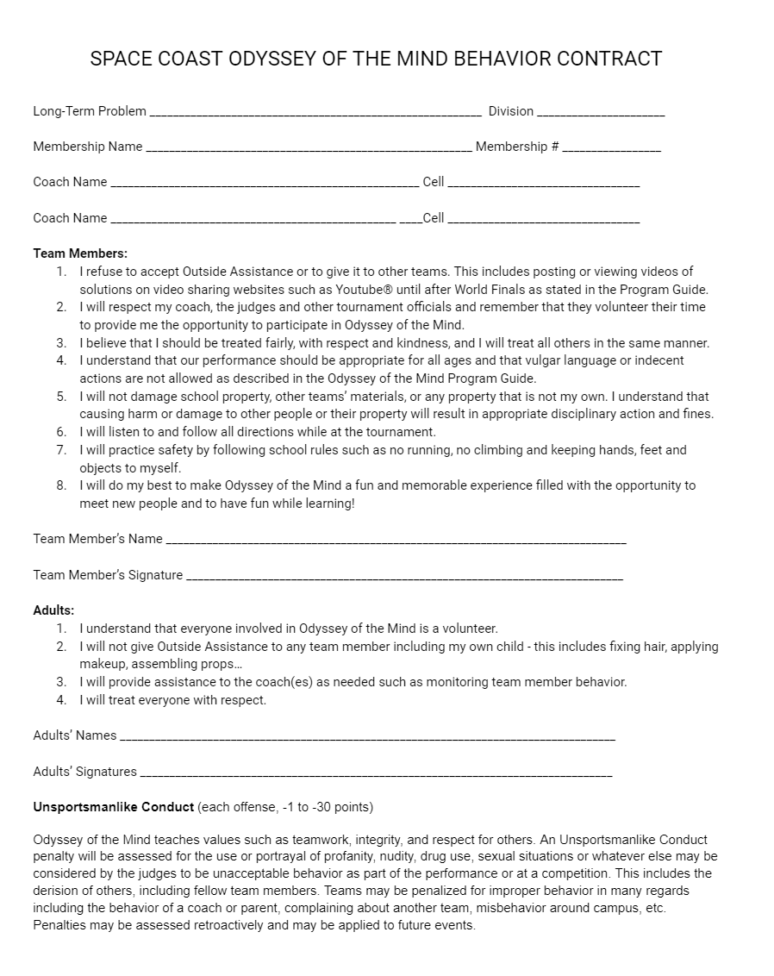
Behavior Contract

Slide 25
Where to find LT forms
Member Resources – Odyssey of the Mind
The Space Coast OM Behavior Contract will be given to you at the end of this meeting and has been emailed to all coaches and coordinators. It will also be available on our website.

Slide 26
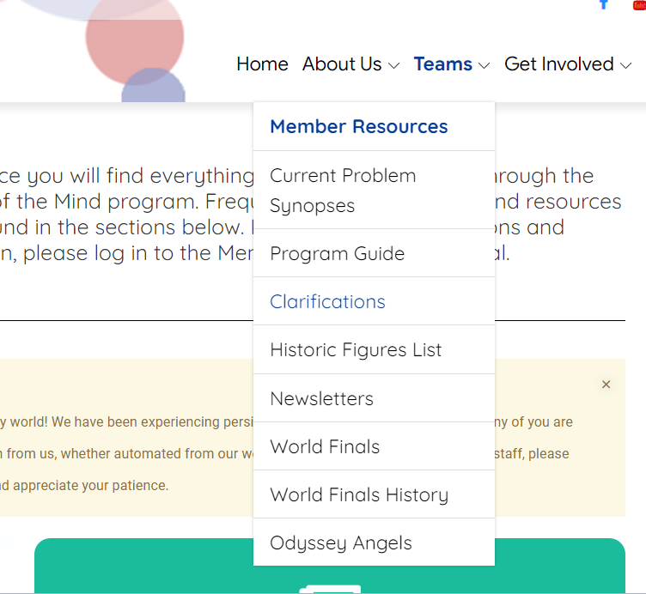
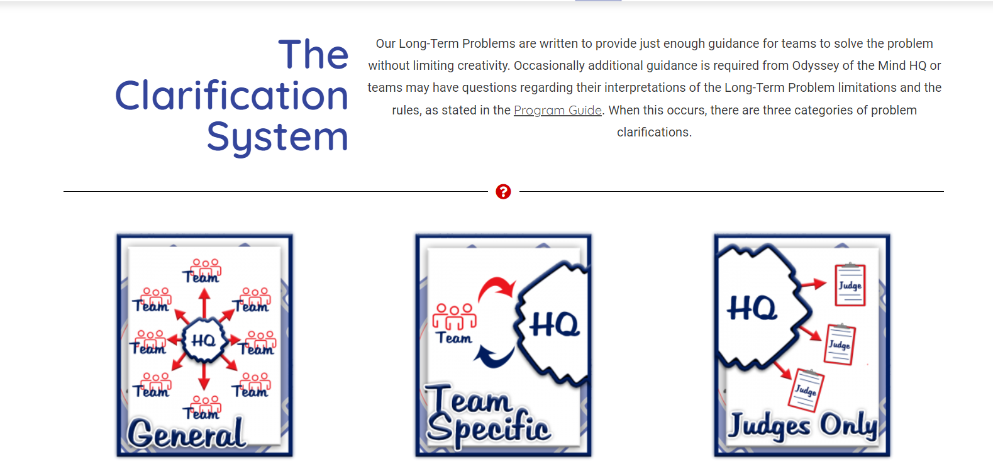
Clarifications
February 15th is the last day to submit clarifications

Slide 27
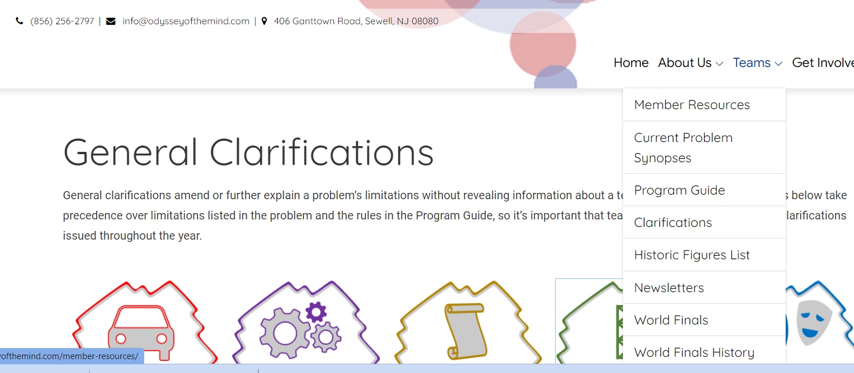
Keep checking, they can issue a General Clarification at any time

Slide 28
WORKER
Check-in – alcove at the end of the main entrance - north breezeway next to admin building
Must show PHOTO ID!
Do not split shift between volunteers
If the volunteer has changed, the new volunteer needs:
Membership Name
Team Problem/Division
Assigned work time
OR BRING THE LETTER YOU WILL GET TONIGHT

Slide 29
Other Info
FOOD OPTIONS
There will be food trucks in the front parking area and concessions sold by Viera High Robotics Club. Food and drinks from off campus may be brought onto campus. Please stress with parents that alcohol and smoking are prohibited. NO GRILLS!
PHOTO OP
We will have a photo op site set up in the OmerFest area. Use the photo op area to take team pictures and ensure all have permission to be photographed before pictures are posted to social media. DO NOT POST PICTURES/VIDEO OF LT SOLUTIONS UNTIL AFTER WORLD FINALS.

Slide 30
Special Needs
Let Sue know if you have a student with special needs that you did not include on your team registration
allergies
recent injuries
illnesses

Slide 31
Omer Fest
South end of courtyard – do not set up your camp in this area
11:30 - 3:00
Jenga, cornhole, Connect 4, art activities, photo ops ….
Scavenger Hunt
We will have a scavenger hunt again this year. Cards will be in your team packets. Teams can get their cards marked by watching various problems or doing activities at the tournament. Completed cards can be turned in at the information table for a vintage OM trading pin.

Slide 32
Competition Sites
Problem 1 – Gymnasium
Problem 2 – Gymnasium
Problem 3 – Bldg. 4, room 123
Problem 4 – Media Center
Weigh In - 108G
Problem 5 - Cafeteria/Auditorium
Primary - Auditorium
Spontaneous – Bldg. 3
Spon check-in at table outside
No spectators in Spontaneous hallway
QR codes are provided for the maps and schedules. They will be activated after this meeting.

Slide 33
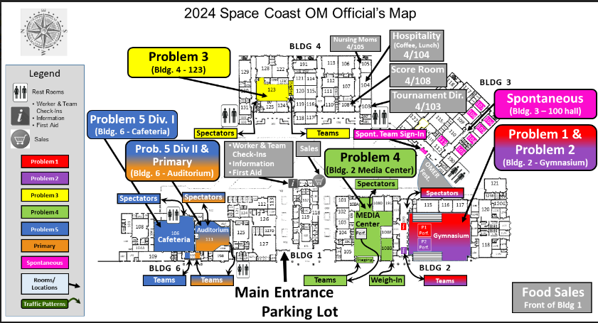
Tournament Map
Pay attention to Team entrance vs Spectator entrance

Slide 34
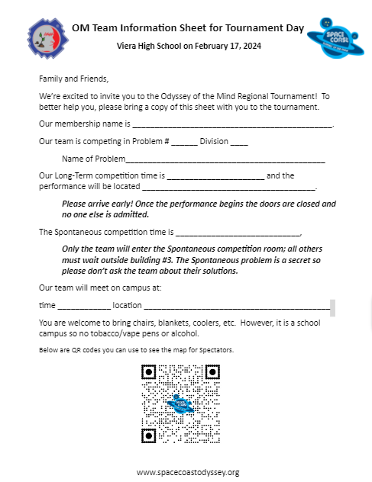
Share Information with Parents
(and tell them to share with extended family)

Slide 35
Competition Day Long-Term
The team needs to decide ahead of time if they will allow photographs and video recording.
You may designate one official photographer if you disallow public photography.
NO VIDEOS SHOULD BE POSTED ONLINE UNTIL AFTER WORLD FINALS.
There is no guarantee that the judges will not get in the way of video. Their goal is to see every aspect of the skit.
Report to your LT problem site about 20 minutes before you are scheduled to compete.
Check with the staging judge to see if they are ready for you. If so, you and parents may, if the team allows, help move props to the pre-staging area.
Adults move to the chairs in the audience after helping

Slide 36
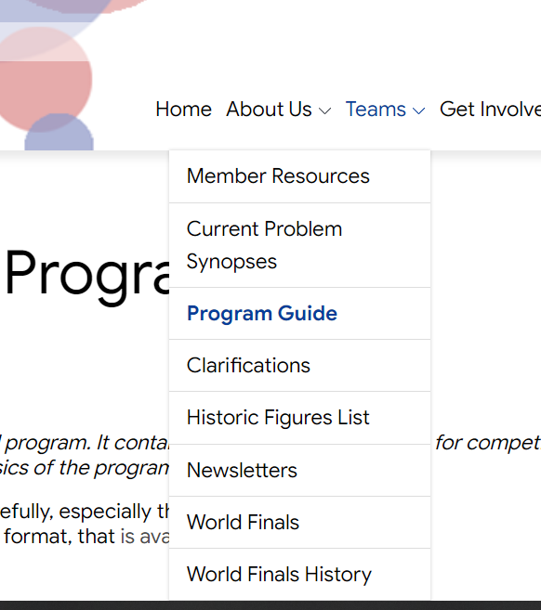
Check Program Guide and Problem for specifics
Doors – All props must fit through a doorway that measure 28”x 78” and must be able to stand or be placed in an upright position in a standard room ceiling (7.7 – 8 ft.)

Slide 37
Check-In at Pre Staging for your Problem
Team gives their paperwork to the Staging Area Judge
If there is a problem with the paperwork, the TEAM will be given a chance to fix it
Division II & III must fill out the paperwork themselves Division I may DICTATE to the coach
Judge checks for footwear and other problem requirements
When competition room is ready, the coach and parents may help the team move props to the STAGING AREA in the room
There will be reserved seats for the coaches
Parents and friends of the team competing are given preference on seating – if you are an observer for another team, please give up front row seats to that team’s guests

Slide 38
Performance
Team, and only the team, waits in staging area to begin their performance.
When the judging team appears ready, the timekeeper will ask if the judges are ready. They will respond.
The team will then be asked if they are ready. Teams should have a prepared way to respond! You can help team create a response - not OA.
The timekeeper will then say, “You may begin!” Time starts and team moves out of staging area and into performance area.
Audience members should be respectful and quiet so all can hear. SILENCE PHONES!
No one can enter or leave during a performance!!!!

Slide 39
When the skit is finished
All video recording must stop.
After the team’s long-term performance, the judges will take some time to talk to the team. Parents and coaches need to stay in the audience during this time.
When the Judges are finished they will return to their tables and the team will clear their props from the room.
At this point, if the team is willing, the coach and the parents can help move the props out.
Remember the team should be prepared to clean up after their performance.
If they need a broom and dustpan due to their skit – BRING THEM!

Slide 40
Long Term Scores
Each site will have a place outside the room where they will post “SCORES ARE READY FOR: “
When the scores are ready the coach may request the scores from the Head Judge (must have coach designation to be recognized as coach by Head Judge)
The coach will receive a long-term score sheet and a page of sticky notes from the Head Judge.
The coach may ask the Head Judge questions or clarifications about the scoring, and the Head Judge records the time the meeting ended on the score sheet.
Disputes or appeals of the scores must be initiated within 30 minutes of the time on the score sheet. After 30 minutes, the scores are sent to the score room. No appeals are heard once the score sheet has reached the score room.
DO NOT LEAVE CAMPUS UNTIL YOU HAVE YOUR SCORES.
To ensure the Awards Ceremony happens on time, you have until 30 minutes after the final team performs in your problem and division to pick up your scores. Even if you do not review with the Head Judge, your raw scores will become final at this time.

Slide 41
APPEALING THE SCORES
If the team feels that an objective score is not correct, there is an appeals process.
The coach returns to the Head Judge (within 30 minutes of marked time) if an appeal is desired. The Head Judge will resolve the conflict; if resolution isn’t possible, then
The Head Judge will involve the Problem Captain. Almost always the Problem Captain is able to settle the appeal. If the appeal is not resolved at this level,
The last appeal is to complete a “Request for Problem Intervention” and agree on a meeting time and place.
The team will then make their case to a tribunal board of a Space Coast Regional Board member, one visiting Florida State Board member, and one nonaffiliated Problem Captain (state or regional) who will make the final decision at that time.
You can read about this process in the Program Guide.

Slide 42
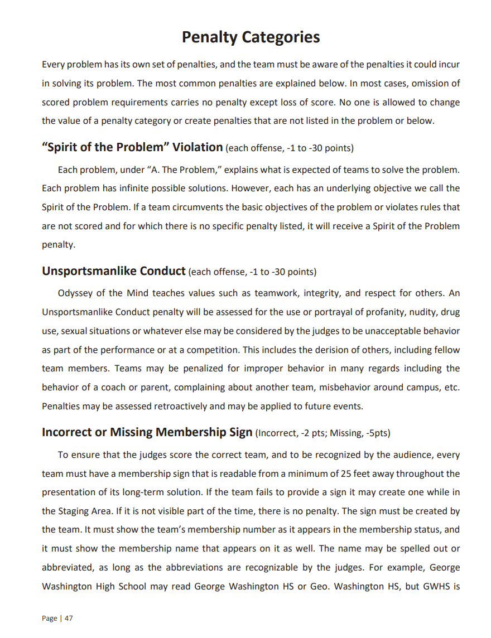
How to avoid Penalties
Please read the problem and program guide carefully
https://www.odysseyofthemind.com/program-guide/#penalty-categories
Spirit of the Problem - each problem in section A explains what is expected; if a team circumvents the basic objective - no going to the next level

Slide 43
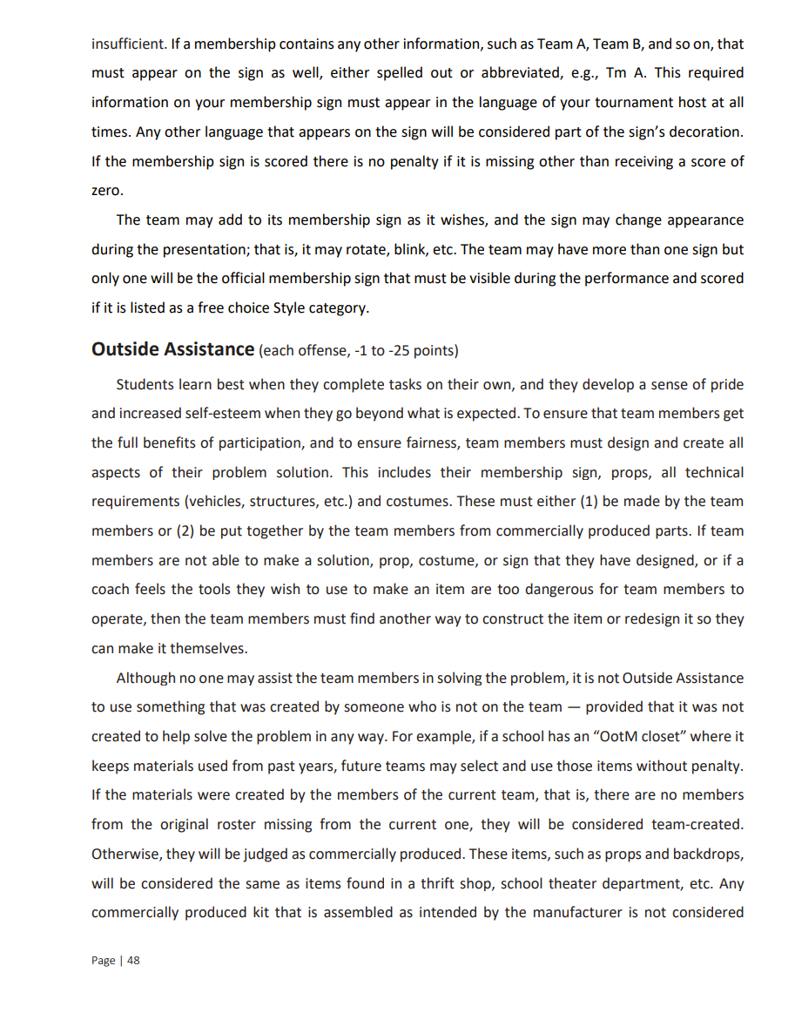
Warn your parents about OA. They have good intentions, but they could cost your team penalty points.

Slide 44
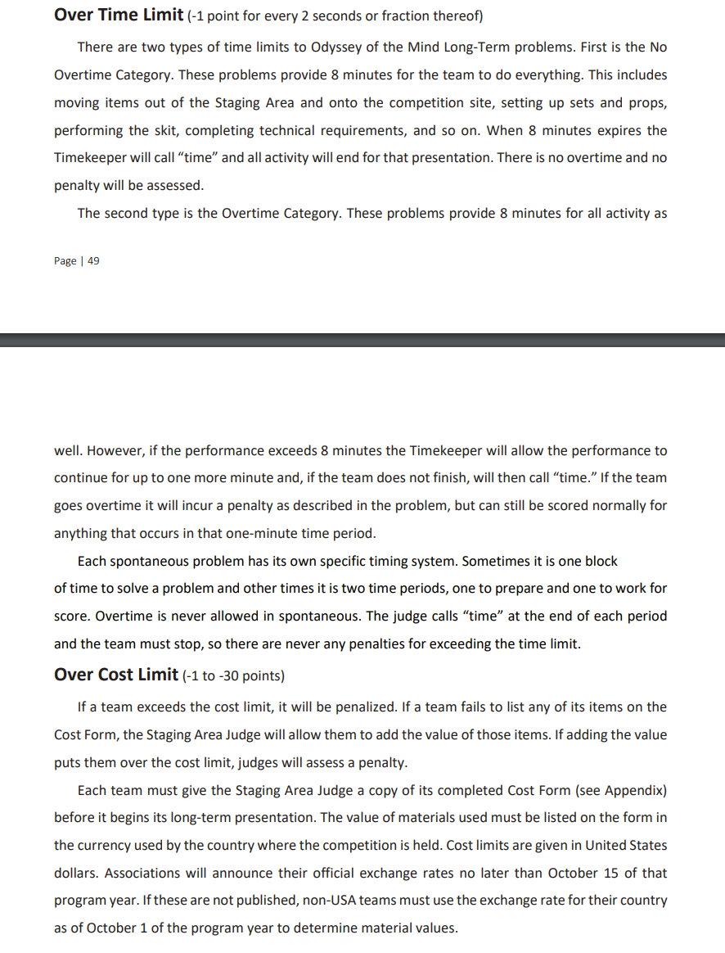
Pay attention to other penalties – such as Over Time Limit and Over Cost Limit

Slide 45
Wisdom from Experience
Hold on to those props! Unless you want to start over, take care of the props after your performance. DO NOT LEAVE THEM ON CAMPUS. You never know, you might be needing them in Orlando ……..
Make a video recording of a full-dress rehearsal to review
Check the message board by information for notices. If your worker does not show, if a problem captain is trying to get hold of you, if we find an item…we will have a note posted on a board by information

Slide 46
Step back and let the team be in charge
Choose one team member to be in charge of giving the paperwork to the staging judge
Give parents details about the day including name of problem/#, division, name of school, site for long term - tell them to share with family members
Have the team dress in matching clothes and/or accessories - t-shirts/hats available for purchase
AND PLEASE PICK UP YOUR TRASH around campus. We will have been on campus since 6:00 AM and we want to go home too!

Slide 47
Awards Ceremony
The Odyssey way!
We give ribbons for 4th & 5th ; medals for 1st, 2nd, 3rd
Coaches of Teams advancing to state meet immediately following the awards ceremony to get State paperwork
No silly string, food or drink. Please clean up around you before you leave
We run a tight ship here. Goal is to be finished in under an hour.
Ceremony will be held at 5:30 in the gym
Doors open at 5:15
Team members sit on floor and adults may sit on lower risers (please do not go up into the stands)
Please talk to your team AND parents about showing respect for all teams and staying until the end.
Following the Awards ceremony the results will be posted to our website.

Slide 48
Spontaneous Award
We are recognizing the top scoring team in each spontaneous competition room.
Team will be called to come forward and each team member will receive a ribbon.
Team will receive a certificate for the school or membership
THIS AWARD DOES NOT ADVANCE THE TEAM TO STATE

Slide 49
Special Awards
RANATRA FUSCA
OMER AWARD
The Ranatra Fusca Creativity Award is presented to teams or individuals who exhibit exceptional creativity.
This is generally awarded for some aspect of a team’s performance or behavior at a competition.
Success in solving the long-term problem is not a criterion for winning this award.
This is designed to encourage risk taking when solving problems.
One Ranatra nomination may be made by a judging team judging a particular problem in each division.
The Ranatra Fusca is considered to be the essence of the Odyssey of the Mind program.
Automatic advancement to next level of competiton
OMER’s Award is named for the Odyssey of the Mind raccoon mascot, OMER, to recognize those individuals, coaches, team members, parents, officials and others who, during a tournament, serve as exemplary examples or role models through their actions or words.
This award is also bestowed on team members who exhibit exceptional skill and talents.
Nominations may be submitted throughout the day at the information desk. Not all nominated will receive the award. A committee will review each nomination and decide on the final recipients.

Slide 50
HOW MANY TEAMS???
PROBLEM 1
DIV. I – 4
DIV. II – 0
DIV. III – 0
PROBLEM 2
DIV. I – 1
DIV. II – 1
DIV. III – 2
PROBLEM 3
DIV. I – 10
DIV. II – 5
DIV. III – 0
PROBLEM 4
DIV. I – 6
DIV. II – 5
DIV. III – 1
PROBLEM 5
DIV. I – 11
DIV. II – 7
DIV. III – 0
PRIMARY 10

Slide 51
Have questions about paperwork?
Please watch the recorded Zoom tutorial on our website

Slide 52
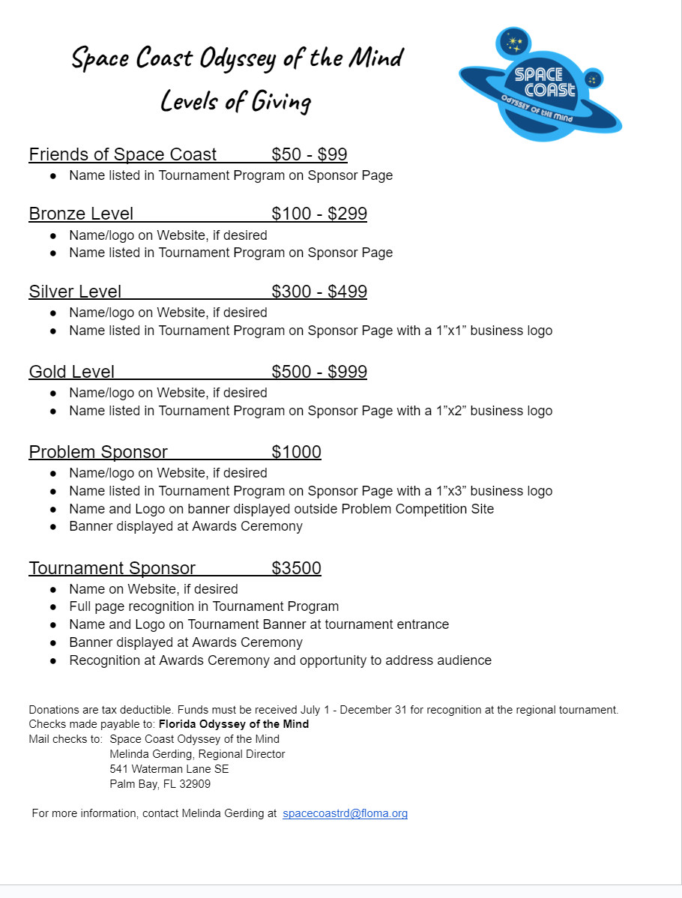
Sponsorships
Please contact me at spacecoastrd@floma.org for more information.

Slide 53
QUESTIONS
???????

Slide 54
Now it’s time!! Distribution of Schedules and Worker Assignments

